Slide 1
Object-Oriented Programming Using C++
Third Edition
Using Classes

Slide 2
Objectives
Create classes
Learn about encapsulating class components
Implement class functions
Use private functions and public data
Use the scope resolution operator with class fields and functions
Use static class members
Learn about the this pointer
Understand the advantages of polymorphism
Object-Oriented Programming Using C++, Third Edition

Slide 3
Creating Classes
A class is a category of objects; it is a new data type
  Classes provide a description of an object
  Classes provide a convenient way to group related data and the functions that use the data
  When you create an object from the class, you automatically create all the related fields
  You think about them and manipulate them as real-life classes and objects
Abstract data type (ADT): a type that you define
Object-Oriented Programming Using C++, Third Edition

Slide 4
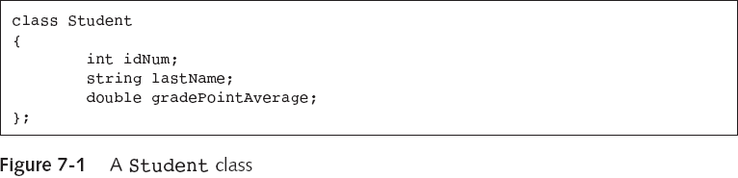
Creating Classes (continued)
Student aSophomore;
aSophomore.idNum = 7645;
cout<<aSophomore.idNum;
Error! By default, all members of a class are private
Object-Oriented Programming Using C++, Third Edition

Slide 5
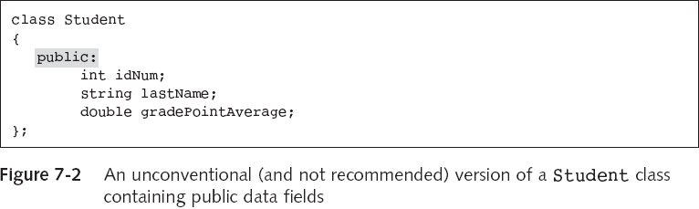
Creating Classes (continued)
Access modifier
Object-Oriented Programming Using C++, Third Edition

Slide 6
Encapsulating Class Components
To encapsulate components is to contain them
  Encapsulation is an example of a black box
An interface intercedes between you and the inner workings of an object
Object-Oriented Programming Using C++, Third Edition

Slide 7
Designing Classes
If you need a class for students, you should ask:
  What shall we call it?
  What are its attributes?
  What methods are needed by Student?
  Any other methods?
In most cases, you declare both fields and functions
  You declare a field using a data type and an identifier
  You declare a function by writing its prototype, which serves as the interface to the function
Object-Oriented Programming Using C++, Third Edition

Slide 8
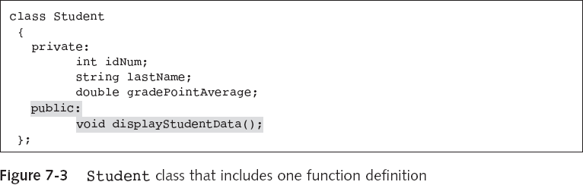
Designing Classes
To instantiate an object is to declare or create it
  Student aSophomore;
  aSophomore.displayStudentData();
A function that uses your class is a class client
Object-Oriented Programming Using C++, Third Edition

Slide 9
Implementing Class Functions
When you construct a class, you create two parts:
  Declaration section: contains the class name, variables (attributes), and function prototypes
  Implementation section: contains the functions
Use both the class name and the scope resolution operator (::) when you implement a class function
Object-Oriented Programming Using C++, Third Edition

Slide 10
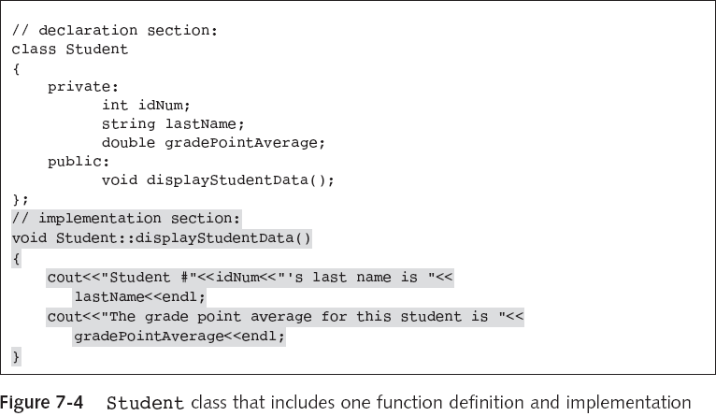
Implementing Class Functions (continued)
Object-Oriented Programming Using C++, Third Edition

Slide 11
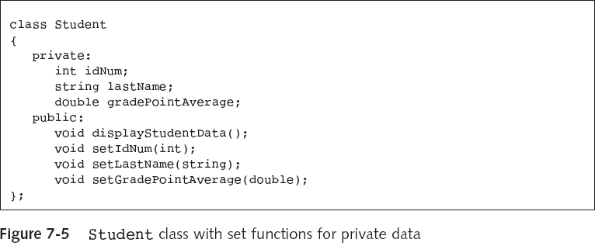
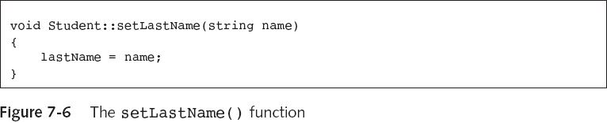
Using Public Functions to Alter Private Data
Object-Oriented Programming Using C++, Third Edition

Slide 12
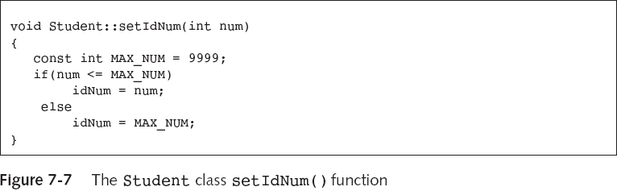
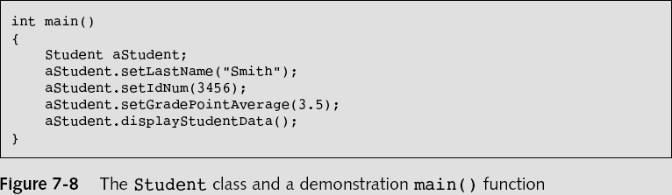
Using Public Functions to Alter Private Data (continued)
…
Object-Oriented Programming Using C++, Third Edition

Slide 13
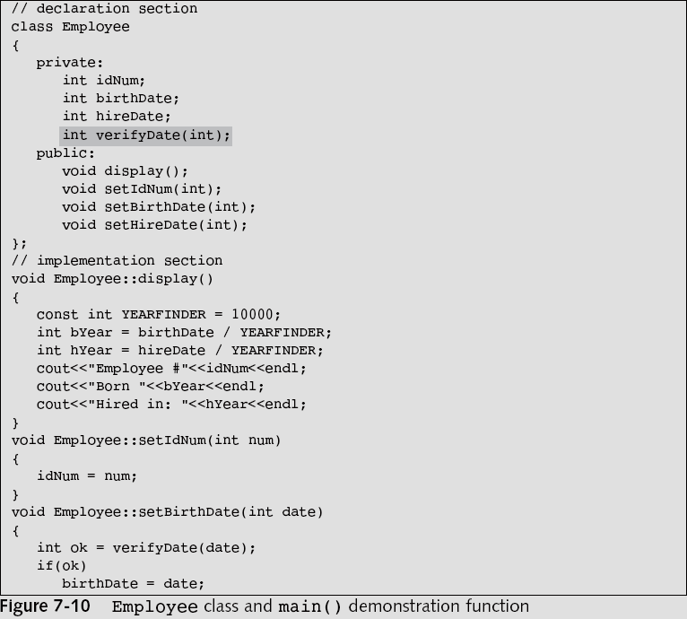
Using Private Functions and Public Data

Slide 14
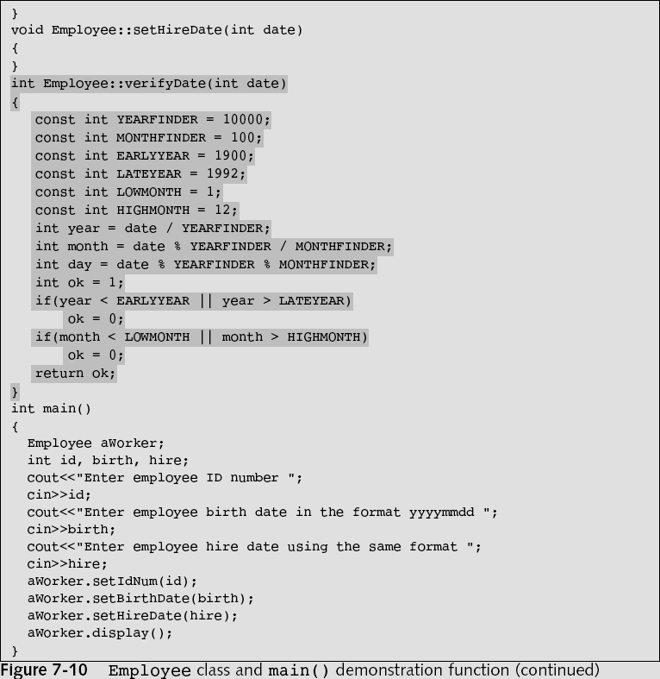
…
…

Slide 15
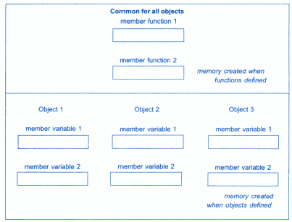
Memory Allocation for Objects
Object-Oriented Programming Using C++, Third Edition

Slide 16
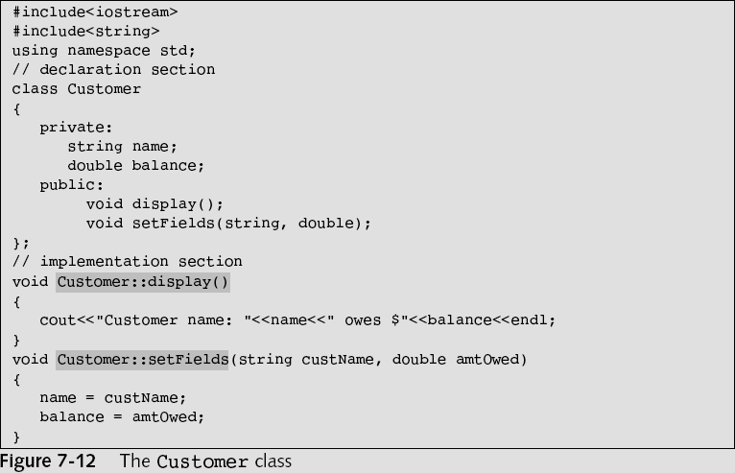
Considering Scope when Defining Member Functions
Object-Oriented Programming Using C++, Third Edition

Slide 17
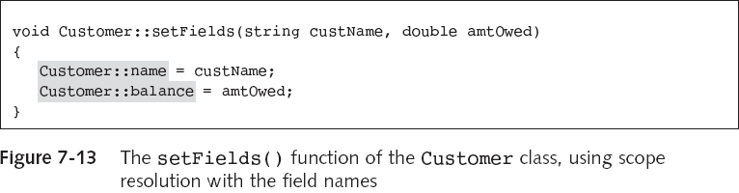
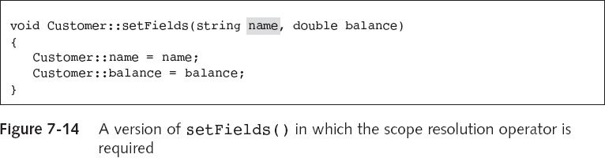
Considering Scope when Defining Member Functions (continued)
Object-Oriented Programming Using C++, Third Edition

Slide 18
Using Static Class Members
When a class field is static, only one memory location is allocated
  All members of the class share a single storage location for a static data member of that same class
When you create a non-static variable within a function, a new variable is created every time you call that function
When you create a static variable, the variable maintains its memory address and previous value for the life of the program
Object-Oriented Programming Using C++, Third Edition

Slide 19
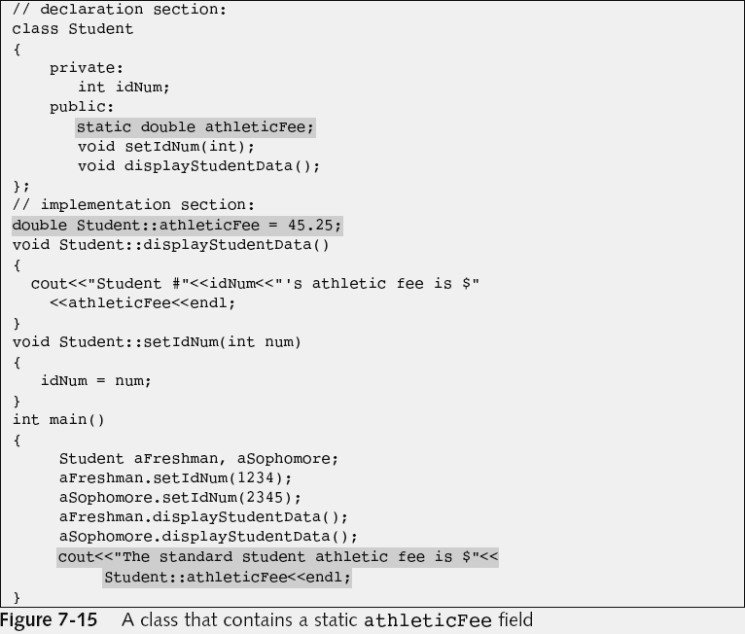
Defining Static Data Members
Since it is not const, anyone can modify it

Slide 20
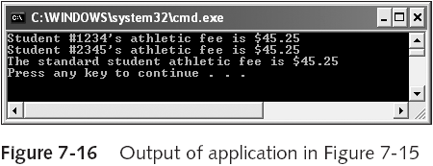
Defining Static Data Members (continued)
Static variables are sometimes called class variables, class fields, or class-wide fields because they don’t belong to a specific object; they belong to the class
Object-Oriented Programming Using C++, Third Edition

Slide 21
Using Static Functions
A static function can be used without a declared object
Non-static functions can access static variables (provided there is an object)
Static functions cannot access non-static variables
Object-Oriented Programming Using C++, Third Edition

Slide 22
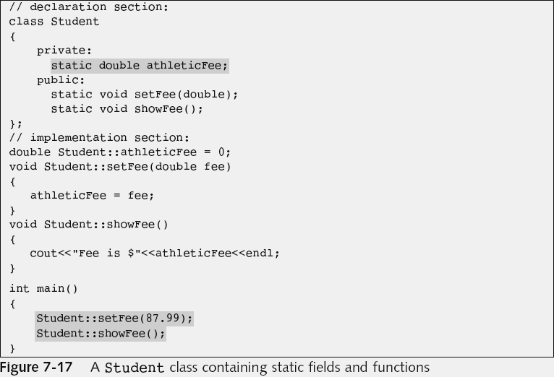
Using Static Functions (continued)

Slide 23
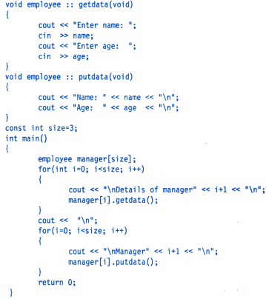
Arrays of Objects

Slide 24
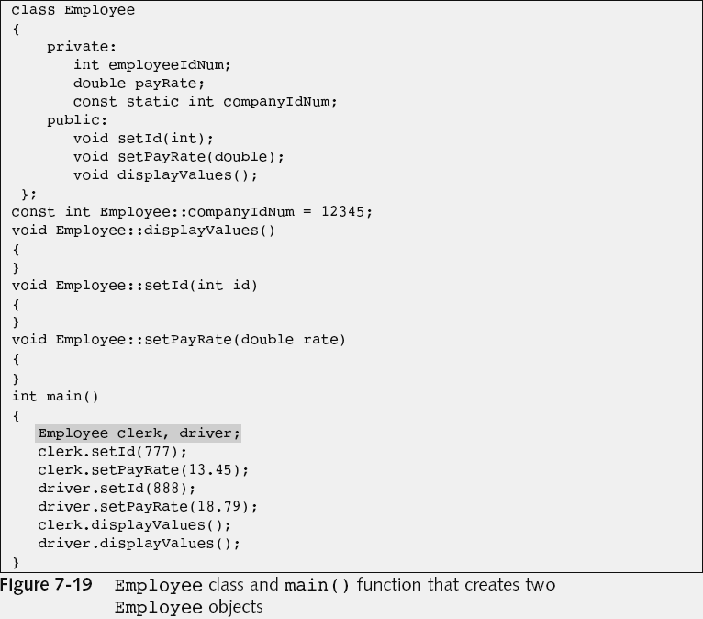
Understanding the this Pointer
…
…
…

Slide 25
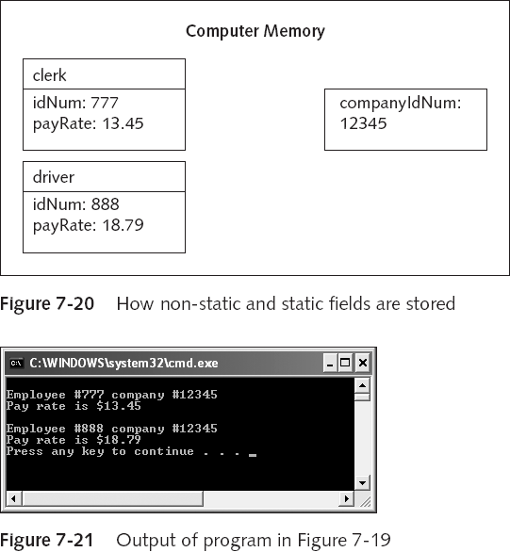
Understanding the this Pointer (continued)
Object-Oriented Programming Using C++, Third Edition

Slide 26
Understanding the this Pointer (continued)
The this pointer holds the memory address of the current object that is using the function
The this pointer is automatically supplied when you call a non-static member function of a class
  For example, clerk.displayValues();
  Is actually displayValues(&clerk);
The actual argument list used by the compiler for displayValues() is displayValues(Employee *this)
The this pointer is a constant pointer
Object-Oriented Programming Using C++, Third Edition

Slide 27
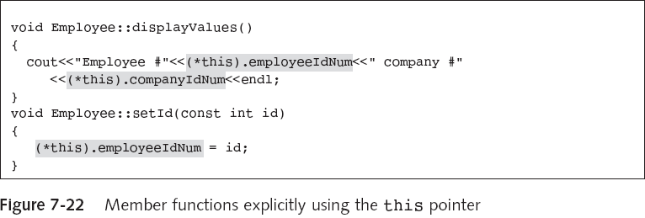
Using the this Pointer Explicitly
Object-Oriented Programming Using C++, Third Edition

Slide 28
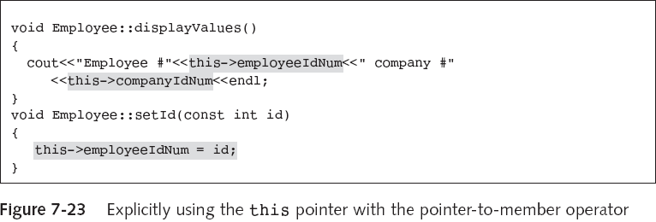
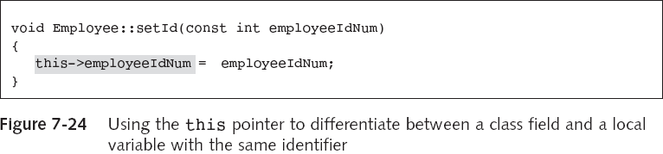
Using the Pointer-to-Member Operator
Object-Oriented Programming Using C++, Third Edition

Slide 29
Understanding Polymorphism
Polymorphism is the object-oriented program feature that allows the same operation to be carried out differently depending on the object
For example,
  clerk.displayValues();
  shirt.displayValues();
  XYZCompany.displayValues();
Object-Oriented Programming Using C++, Third Edition

Slide 30
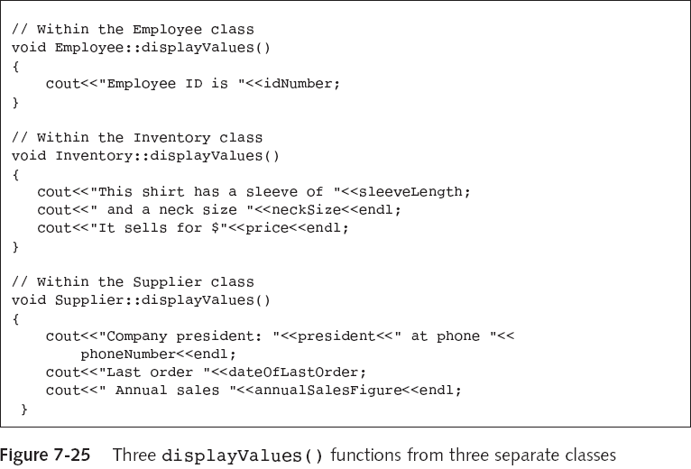
Understanding Polymorphism (continued)
Object-Oriented Programming Using C++, Third Edition

Slide 31
You Do It: Creating and Using a Class
class CollegeCourse
{
private:
string department;
int courseNum;
int seats;
public:
void setDepartmentAndCourse(string, int);
void setSeats(int);
void displayCourseData();
};
Object-Oriented Programming Using C++, Third Edition

Slide 32
Using a static Field
class Letter
{
private:
string title;
string recipient;
static int count;
public:
void setRecipient(string, string);
void displayGreeting();
static void displayCount();
};
Object-Oriented Programming Using C++, Third Edition

Slide 33
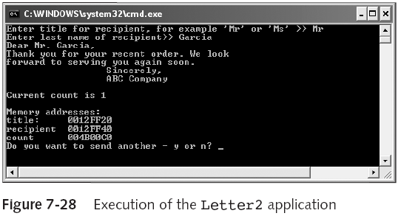
Understanding How static and Non-static Fields are Stored
Object-Oriented Programming Using C++, Third Edition

Slide 34
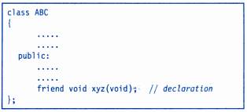
Friend Function
Object-Oriented Programming Using C++, Third Edition

Slide 35
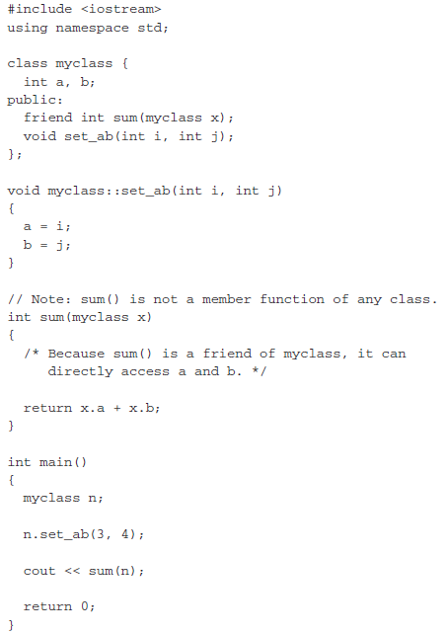
Friend Function

Slide 36
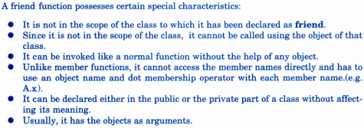
Friend function Characteristics
Object-Oriented Programming Using C++, Third Edition

Slide 37
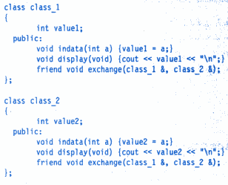
Function friend to 2 Classes

Slide 38
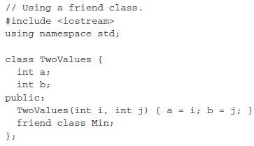
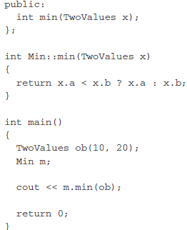
Friend Classes
Object-Oriented Programming Using C++, Third Edition

Slide 39
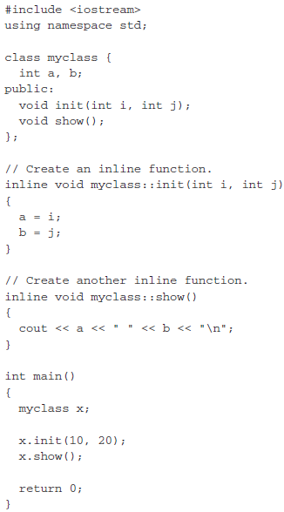
Inline Functions

Slide 40
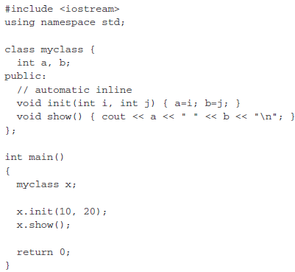
Inline Functions within Class

Slide 41
Constructors
Enables the objects to initialize itself when they are created.
Also, known as automatic initialization of objects.
Constructor is invoked when object of its associated class is created.
Object-Oriented Programming Using C++, Third Edition

Slide 42
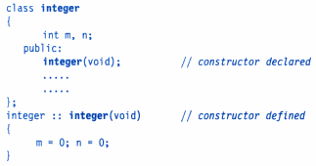
Constructor
Object-Oriented Programming Using C++, Third Edition

Slide 43
Default Constructor
It is the Constructor that accepts no parameters.
Example: Constructor for class A is:
  A::A()
Object-Oriented Programming Using C++, Third Edition

Slide 44

Characteristics of Constructors
Object-Oriented Programming Using C++, Third Edition

Slide 45
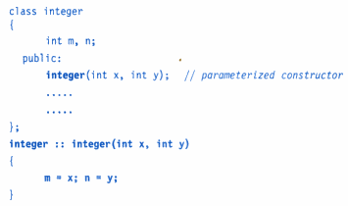
Parameterized Constructor
Object-Oriented Programming Using C++, Third Edition

Slide 46
2 ways of calling Constructors
1)
2)
Object-Oriented Programming Using C++, Third Edition

Slide 47
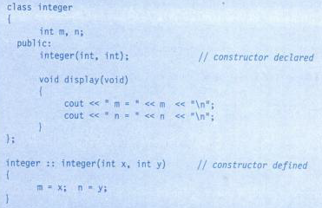
Example of Constructor
Object-Oriented Programming Using C++, Third Edition

Slide 48
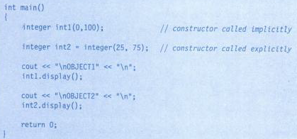
Example of Constructor (cont.)
Object-Oriented Programming Using C++, Third Edition

Slide 49
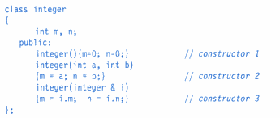
Multiple Constructor in Class
integer Obj3(obj2)
  Copies the values of Obj2 into Obj3.
Object-Oriented Programming Using C++, Third Edition

Slide 50
Copy Constructor
Used to declare and initialize object from another object.
Example:
Another form:
Also, will not invoke copy constructor, but performs same task
Object-Oriented Programming Using C++, Third Edition

Slide 51
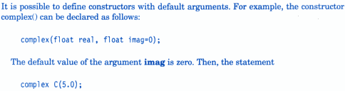

Constructors with Default Arguments

Slide 52
Destructors
Used to destroy objects created by constructors.
Like constructor, it has same name as class name, but preceded by tilde (~).
Example:
They don’t take any argument, nor return value.
It is invoked implicitly by compiler upon exit from program (or block or function) to clean-up storage.
Object-Oriented Programming Using C++, Third Edition

Slide 53
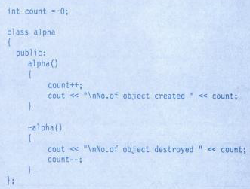
Example of Destructor

Slide 54
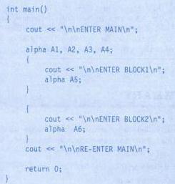
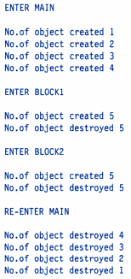
Example of Destructor (cont.)
Object-Oriented Programming Using C++, Third Edition

Slide 55
Dynamic Constructors
It is the allocation of memory to objects at the time of their construction.
Used to allocate memory while creating objects.
Enables to allocate right amount of memory for each object.
Object-Oriented Programming Using C++, Third Edition

Slide 56
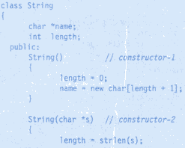


Slide 57

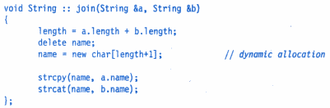

Slide 58
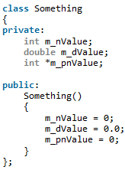
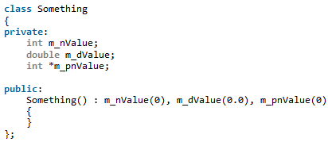
Initialization List
Using assignment operator
Using Initialization List

Slide 59
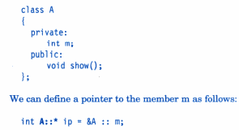

Pointer to Objects and members

Slide 60
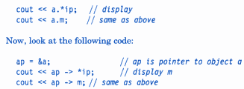
If ‘a’ is an object of class “A” and ‘m’ as member variable, and ‘ip’ as pointer then:
Object-Oriented Programming Using C++, Third Edition

Slide 61
